Slide 1
2020 REVISED CURRICULUM AND ASSESSMENT PLANS MATHEMATICS GRADE 7 Implementation: June 2020

Slide 2
Presentation Outline
Purpose
Amendments to the Content Overview for the Phase;
Amendments to the Annual Teaching Plan;
Amendments School Based Assessment (SBA)
Conclusion

Slide 3
1. Purpose
To mediate the amendments of the trimmed and re-organised 2020 Annual Teaching Plan including School Based Assessment for Subject, Grade 7 for implementation in June 2020 as stipulated in Circular S2 of 2020.
To ensure that meaningful teaching proceeds during the remaining teaching time as per the revised school calendar.
To assist teachers with guided pacing and sequencing of curriculum content and assessment.

Slide 4
1. Purpose (continued)
To enable teachers to cover the essential core content /skills in each grade within the available time.
To assist teachers with planning for the different forms of assessment.
To ensure learners are adequately prepared for the subsequent year/s in terms of content, skills, knowledge, attitudes and values

Slide 5
2. Amendments to the Content Overview for the Phase

Slide 6
Summary: Amendments to the Content Overview for the Phase
COMMON FRACTIONS
Grade 7 | Grade 8 | Grade 9
Add, subtract and multiply common fractions where denominators are neither the same nor multiples of one another | Divide whole numbers and common fractions by common fractions Calculate the squares, cubes, square roots and cube roots of common fractions | All four operations, with numbers that involve the squares, cubes, square roots and cube roots of common fractions DONE IN TERM 1

Slide 7
Summary: Amendments to the Content Overview for the Phase
DECIMAL FRACTIONS
Grade 7 | Grade 8 | Grade 9
Order, compare and place value of decimals (3 decimal places) and rounding off (2 decimal places) Add and subtract decimal fractions (3 decimal places) Multiply decimal fractions 3 decimal places by whole numbers 2 decimal places by decimal fractions to at least 1 decimal place Divide decimal fractions by whole numbers | Divide whole numbers and common fractions by common fractions Calculate the squares, cubes, square roots and cube roots of common fractions | All four operations, with numbers that involve the squares, cubes, square roots and cube roots of common fractions DONE IN TERM 1

Slide 8
Summary: Amendments to the Content Overview for the Phase
PERCENTAGES
Grade 7 | Grade 8 | Grade 9
Calculate the percentage of part of a whole Calculate percentage increase or decrease of whole numbers Recognize equivalence between common fraction, decimal fraction and percentage forms of the same number | Calculate amounts if given percentage increase or decrease

Slide 9
Summary: Amendments to the Content Overview for the Phase
INTEGERS
Grade 7 | Grade 8 | Grade 9
Count , order and compare integers Add and subtract with integers Use commutative, associative and distributive properties of addition and multiplication for integers Solve problems in contexts involving addition and subtraction with integers | Multiply and divide with integers Perform calculations involving all four operations with integers Perform calculations involving all four operations with numbers that involve the squares, cubes, square roots and cube roots of integers Recognize and use additive and multiplicative inverses for integers Solve problems in contexts involving multiple operations with integers DONE IN TERM 1

Slide 10
Summary: Amendments to the Content Overview for the Phase
NUMERIC AND GEOMETRIC PATTERNS
Grade 7 | Grade 8 | Grade 9
Investigate and extend patterns looking for relationship or rules in own words | Investigate and extend patterns looking for relationship or rules in algebraic language DONE IN TERM 1 | Investigate and extend patterns looking for relationship or rules in algebraic language DONE IN TERM 1

Slide 11
Summary: Amendments to the Content Overview for the Phase
ALGEBRAIC EXPRESSIONS
Grade 7 | Grade 8 | Grade 9
Recognize and interpret rules or relationships represented in symbolic form Identify variables and constants in given formulae and/or equations | Recognize and identify conventions for writing algebraic expressions Identify and classify like and unlike terms in algebraic expressions Recognize and identify coefficients and exponents in algebraic expressions Expand and simplify algebraic expressions | Factorise algebraic expressions Simplify algebraic expressions involving factorisation

Slide 12
Summary: Amendments to the Content Overview for the Phase
ALGEBRAIC EQUATIONS
Grade 7 | Grade 8 | Grade 9
Solve equations by substitution, inspection and trial and improvement | Solve equations by additive and multiplicative inverse | Solve equations by additive and multiplicative inverse Solve equations by factorisation

Slide 13
Summary: Amendments to the Content Overview for the Phase
FUNCTIONS AND RELATIONSHIPS
Grade 7 | Grade 8 | Grade 9
Determine input values, output values or rules for patterns and relationships using flow diagrams, tables and formulae Determine, interpret and justify equivalence of different descriptions of the same relationship or rule presented verbally, in flow diagrams, in tables, by formulae and by number sentences | Incorporated in the algebraic expressions | Extend determining input values, output values or rules for patterns and relationships to include equations Extend determining, interpreting and justifying equivalence of different descriptions of the same relationship or rule to include representing the equivalence by means of equations and by graphs on a Cartesian plane

Slide 14
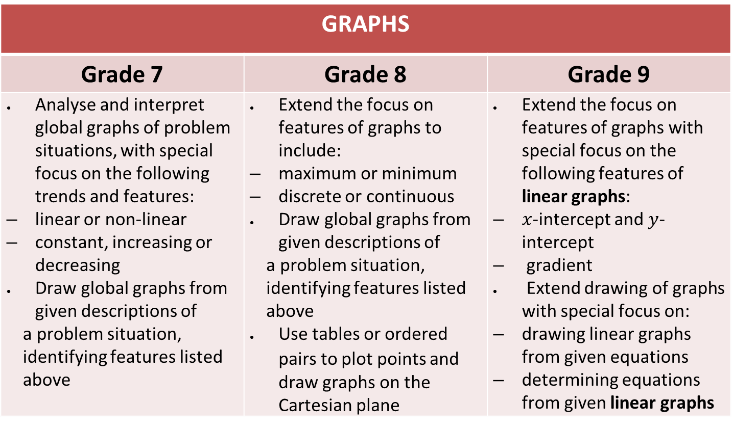
Summary: Amendments to the Content Overview for the Phase
GRAPHS
Grade 7 | Grade 8 | Grade 9
Analyse and interpret global graphs of problem situations, with special focus on the following trends and features: linear or non-linear constant, increasing or decreasing Draw global graphs from given descriptions of a problem situation, identifying features listed above | Extend the focus on features of graphs to include: maximum or minimum discrete or continuous Draw global graphs from given descriptions of a problem situation, identifying features listed above Use tables or ordered pairs to plot points and draw graphs on the Cartesian plane | Extend the focus on features of graphs with special focus on the following features of linear graphs: $x$-intercept and $y$-intercept gradient Extend drawing of graphs with special focus on: drawing linear graphs from given equations determining equations from given linear graphs

Slide 15
Summary: Amendments to the Content Overview for the Phase
GEOMETRY OF 2D SHAPES
Grade 7 | Grade 8 | Grade 9
 | Investigating properties of geometric figures By construction, investigate the angles in a triangle, focusing on: the sum of the interior angles of triangles the size of angles in an equilateral triangle the sides of and angles opposite to equal sides in an isosceles triangle | Investigating properties of geometric figures By construction, investigate the angles in a triangle, focusing on the relationship between the exterior angle of a triangle and its interior angles

Slide 16
Summary: Amendments to the Content Overview for the Phase
GEOMETRY OF 2D SHAPES cont…
Grade 7 | Grade 8 | Grade 9
 | Investigating properties of geometric figures By construction, investigate sides and angles in quadrilaterals, focusing on: the sum of the interior angles of quadrilaterals the sides and opposite angles of parallelograms N.B. Provide learners with accurately constructed figures to investigate the properties | Investigating properties of geometric figures By construction, investigate sides, angles and diagonals in quadrilaterals, focusing on: the diagonals of rectangles, squares, parallelograms, rhombi and kites exploring the sum of the interior angles of polygons By construction, explore the minimum conditions for two triangles to be congruent N.B. Provide learners with accurately constructed figures to investigate the properties

Slide 17
Summary: Amendments to the Content Overview for the Phase
GEOMETRY OF 2D SHAPES cont….
Grade 7 | Grade 8 | Grade 9
Classification of 2 D shapes Describe, sort, name and compare triangles Describe, sort, name and compare quadrilaterals Describe and name parts of a circle | Classification of 2 D shapes Identify and write clear definitions of triangles Identify and write clear definitions of quadrilaterals focusing on sides | Classification of 2 D shapes Write clear definitions of quadrilaterals focusing on diagonals

Slide 18
Summary: Amendments to the Content Overview for the Phase
GEOMETRY OF 2D SHAPES cont….
Grade 7 | Grade 8 | Grade 9
Similar and congruent 2D shapes Recognize and describe similar and congruent figures by comparing size and shape | Similar and congruent 2D shapes Identify and describe the properties of congruent shapes Identify and describe the properties of similar shapes Solving problems Extend solving geometric problems to include definitions. | Similar and congruent triangles Through investigation, establish the minimum conditions for congruent triangles Through investigation, establish the minimum conditions for similar triangles Solving problems Extend solving geometric problems to include properties of congruent and similar triangles.

Slide 19
Summary: Amendments to the Content Overview for the Phase
GEOMETRY OF 3D OBJECTS
Grade 7 | Grade 8 | Grade 9
EXCLUDED | EXCLUDED | EXCLUDED

Slide 20
Summary: Amendments to the Content Overview for the Phase
GEOMETRY OF STRAIGHT LINES
Grade 7 | Grade 8 | Grade 9
Definitions DONE IN TERM 1 | Angle relationships Solving problems | Angle relationships Solving problems

Slide 21
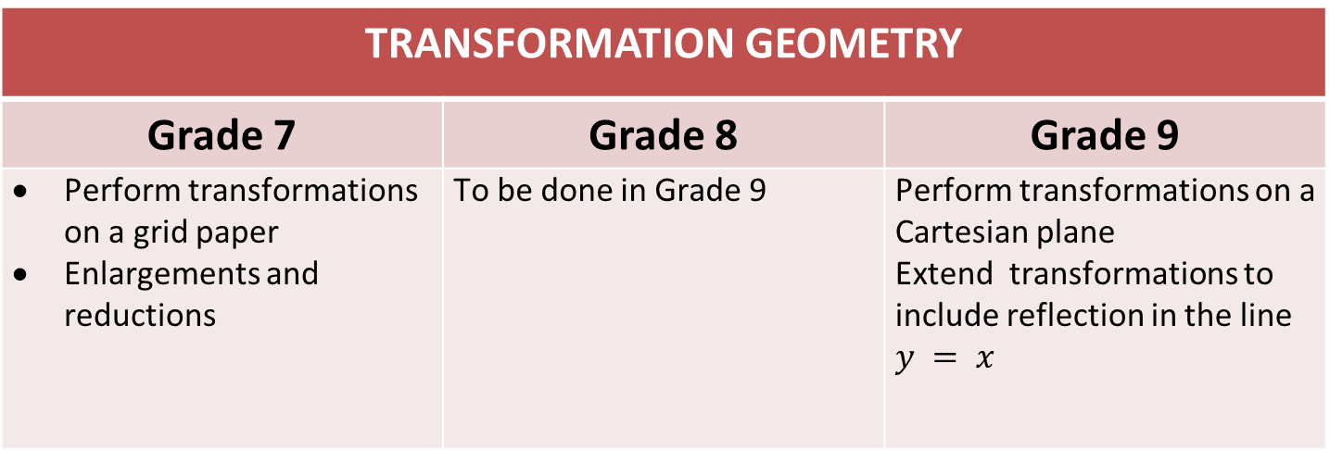
Summary: Amendments to the Content Overview for the Phase
TRANSFORMATION GEOMETRY
Grade 7 | Grade 8 | Grade 9
Perform transformations on a grid paper Enlargements and reductions | To be done in Grade 9 | Perform transformations on a Cartesian plane Extend transformations to include reflection in the line $y = x$

Slide 22
Summary: Amendments to the Content Overview for the Phase
AREA AND PERMITER OF 2D SHAPES
Grade 7 | Grade 8 | Grade 9
Use appropriate formulae to calculate perimeter and area of squares, rectangles and triangles to at least I decimal place and convert units from mm² to cm² and cm² to m² | Extend use of appropriate formulae to calculate perimeter and area of polygons to include circles to at least 2 decimal places and convert between appropriate SI units, including and up to km² Calculate perimeter and area of complex figures | Use appropriate formulae and conversions between SI units, to solve problems and calculate perimeter and area of polygons and circles. Investigate how doubling any or all of the dimensions of a 2D figure affects its perimeter and its area

Slide 23
Summary: Amendments to the Content Overview for the Phase
SURFACE AREA AND VOLUME OF 3D OBJECTS
Grade 7 | Grade 8 | Grade 9
Use appropriate formulae to calculate the surface area, volume and capacity of cubes and rectangular prisms Describe the interrelationship between surface area and volume of the objects mentioned above | Extend use appropriate formulae to calculate the surface area, volume and capacity of triangular prisms Describe the interrelationship between surface area and volume of the objects mentioned above | Extend use appropriate formulae to calculate the surface area, volume and capacity of cylinders Investigate how doubling any or all the dimensions of right prisms and cylinders affects their volume

Slide 24
Summary: Amendments to the Content Overview for the Phase
SURFACE AREA AND VOLUME OF 3D OBJECTS cont…
Grade 7 | Grade 8 | Grade 9
Use and convert between appropriate SI units, including: mm² ↔ cm² cm² ↔ m² mm³ ↔ cm³ cm³ ↔ m³ Use equivalence between units when solving problems: 1 cm³ ↔ 1 ml 1 m³ ↔ 1 kl | Use and convert between appropriate SI units, including: mm² ↔ cm² ↔ m² ↔ km² mm³ ↔ cm³ ↔ m³ ml (cm³) ↔ l ↔ kl

Slide 25
Summary: Amendments to the Content Overview for the Phase
PYTHAGORAS THEOREM
Grade 7 | Grade 8 | Grade 9
 | Develop and use the Theorem of Pythagoras | Solve problems using the Theorem of Pythagoras

Slide 26
Summary: Amendments to the Content Overview for the Phase
COLLECT, ORGANISE, REPRESENT, SUMMARISE AND INTERPRET DATA
Grade 7 | Grade 8 | Grade 9
Complete data cycle with bar graphs, pie charts and histograms Identify the largest and smallest scores in a data set and determine the difference between them in order to determine the spread of the data (range) | Extend completion of data cycle with graphs to include broken line graphs Summarise data using measures of dispersion, including: range extremes | Extend completion of data cycle with graphs to include scatter plots Extend summarising data using measures of dispersion to include outliers

Slide 27
Summary: Amendments to the Content Overview for the Phase
COLLECT, ORGANISE, REPRESENT, SUMMARISE AND INTERPRET DATA
Grade 7 | Grade 8 | Grade 9
Complete data cycle with bar graphs, pie charts and histograms Identify the largest and smallest scores in a data set and determine the difference between them in order to determine the spread of the data (range) | Extend completion of data cycle with graphs to include broken line graphs Summarise data using measures of dispersion, including: range extremes | Extend completion of data cycle with graphs to include scatter plots Extend summarising data using measures of dispersion to include outliers

Slide 28
Summary: Amendments to the Content Overview for the Phase
ANALYSE DATA
Grade 7 | Grade 8 | Grade 9
Critically analyse data by answering questions related to: data categories, including data intervals data sources and contexts central tendencies (mean, mode, median) scales used on graphs | Extend critical analysis of data to include: samples and populations dispersion of data error and bias in the data | Extend critical analysis of data to include: data collection methods summary of data sources of error and bias in the data

Slide 29
Summary: Amendments to the Content Overview for the Phase
REPORT DATA
Grade 7 | Grade 8 | Grade 9
Report data in short paragraphs by: drawing conclusions about the data making predictions based on the data identifying sources of error and bias in the data choosing appropriate summary statistics for the data (mean, median, mode) | Extend reporting data in short paragraphs to include: choosing appropriate summary statistics for the data (mean, median, mode, range) the role of extremes in the data | Extend reporting data in short paragraphs to include: choosing appropriate summary statistics for the data (mean, median, mode, range) the role of extremes and outliers in the data

Slide 30
Summary: Amendments to the Content Overview for the Phase
PROBABILITY
Grade 7 | Grade 8 | Grade 9
 |  | Consider situations with equally probable outcomes, and: determine probabilities for compound events using two- way tables and tree diagrams determine the probabilities for outcomes of events and predict their relative frequency in simple experiments compare relative frequency with probability and explains possible differences

Slide 31
3. Amendments to the Annual Teaching Plan

Slide 32
Summary: Reorganisation of content topics
Topics that are repetitive have been merged and dealt with once, but in depth
The following have been left out:
Topics that have been dealt with in the previous phase without progression
Topics that will be dealt with in the next phase with little or no progression
Topics that were taught in Term 1, however these topics will be assessed in the end of the year examinations

Slide 33
Summary: Reorganisation of content topics
The focus is on new concepts and skills
Some topics have been moved from one term to the next due to the following reasons:
Lack of time in the term
To incorporate other topics dealt with
Topics that link with each other have been dealt with, one after the other

Slide 34
Summary: Reorganisation of content topics
Hours in some topics have been reduced due to the following reasons:
Repetition, hence merged
Amount of work to be done is introductory
Numbers operations and relationships to be dealt with before all other topics since they form part of almost every topic

Slide 35
Summary: Content/Topics Amended
Content/Topics | Term | Amendment
1.4 Common Fractions | 2 | Nothing done
1.5 Decimal Fractions | 2 | Nothing done
1.3 Integers | 2 | Moved from Term 4 to Term 2

Slide 36
Summary: Content/Topics Amended
Content/Topics | Term | Amendment
2.1 Patterns | 4 | Merged and Moved to term 4
2.3 Algebraic Expressions | 3 | Merged and reduced from 6 hrs. to 3 hrs. Incorporates integers
2.4 Algebraic Equations | 3 | Merged and Reduced from 7 hrs. to 4.5 hrs.

Slide 37
Summary: Content/Topics Amended
Content/Topics | Term | Amendment
2.2 Functions and Relationships | 3 | Merged and Reduced from 6 hrs. to 3 hrs.
2.5 Graphs | 3 | Reduced from 6 hrs. to 4.5 hrs.
3.2 Geometry of 3 D objects |  | Removed

Slide 38
Summary: Content/Topics Amended
Content/Topics | Term | Amendment
3.4 Transformation Geometry | 4 | Moved to term 4 after teaching area and perimeter of 2D shapes
4.1 Area and Perimeter of 2D shapes | 3 | Moved to Term 3 after expressions, functions and equations
4.2 Surface Area and Volume of 3D objects | 3 | Moved to term 3 after expressions, functions , equations; and area and perimeter of 2 D shapes

Slide 39
Summary: Content/Topics Amended
Content/Topics | Term | Amendment
5.1 and 5.2 Collect, organise represent and summarise data | 4 | Reduced from 10.5 hours to 7 hours and merged with 5.3
5.3 Interpret, Analyse and report data | 4 | Reduced from 10.5 hours to 7 hours and merged with 5.1 and 5.2
5.4 Probability | 4 | Removed

Slide 40
4. Amendments School Based Assessment (SBA)

Slide 41
Summary: Revised Programme of Assessment
Term 1 | Term 2 | Term 3 | Term 4
Assignment | Assignment | Investigation | Test
Test |  |  | Examination
For mark allocation per task see Abridged CAPS Section 4 No June Examination No Project

Slide 42
Summary: Revised Programme of Assessment
WEIGHTING OF TASKS FOR SBA AND END OF THE YEAR EXAMINATIONS
 | Term | Tasks | 100 % | 80 % | 20%
SBA | 1 | Assignment | 20 % | 16 %
 |  | Test | 15 % | 12 %
 | 2 | Assignment | 25 % | 20 %
 | 3 | Investigation | 20 % | 16 %
 | 4 | Test | 20 % | 16 %
End of the Year Examinations |  |  | 100 % |  | 20 %

Slide 43
Summary: Revision Final Examination Structure
As in Abridged CAPS Section 4
Paper 1: Numbers, operations, and relationships; patterns, functions and algebra
Paper 2: Space and Shape, Measurement and Data Handling

Slide 44
4. Conclusion

Slide 45
Conclusion
The revised CAPS must be used in conjunction with clarification notes in CAPS.
For tests and examinations, mark allocation will apply in accordance with ‘Reorganised’ CAPS.
Cognitive levels and weighting of content areas will apply in accordance with CAPS
N.B. ‘Reorganised CAPS’ document is an interim arrangement due to COVID 19

Slide 46
Contact Details
Name: Ms CF Mtumtum: Mathematics
Department of Basic Education
Tel: 012 357 4177
Email: Mtumtum.C@dbe.gov.za

